Slide 1
MUTHURANGAM GOVT ARTS AND SCIENCE COLLEGE VELLORE -2
A CRM APPLICATION FOR SCHOOLS/COLLEGES
Project Submitted by:-
TEAM LEADER: S.Siva Shankari
TEAM MEMBERS: B.Snega
P.Saranya
R.Tamilselvi
S.Vedhanayagi

Slide 2
CONTENT:-
Milesone 1:
Creating Developer Account
Milestone 2:
Creation of Objects for School Management:
1. Creation of School Object
2. Create Student Object
3. Create Parent Object
Milestone 3:
Lightning App
1.Create the School Management App
Milestone 4:
Field and Relationship
1.Creation of fields for the School Objects
2.Creation of fields for the Student Objects
3.Creation of fields for the Parent Objets
Milestone 5:
Profile
1.Creation on profile

Slide 3
Milestone 6:
Create a Users
Milestone 7:
Permission Sets
1.Permission Sets 1
2.Permission Sets 2
Milestone 8:
Reports

Slide 4
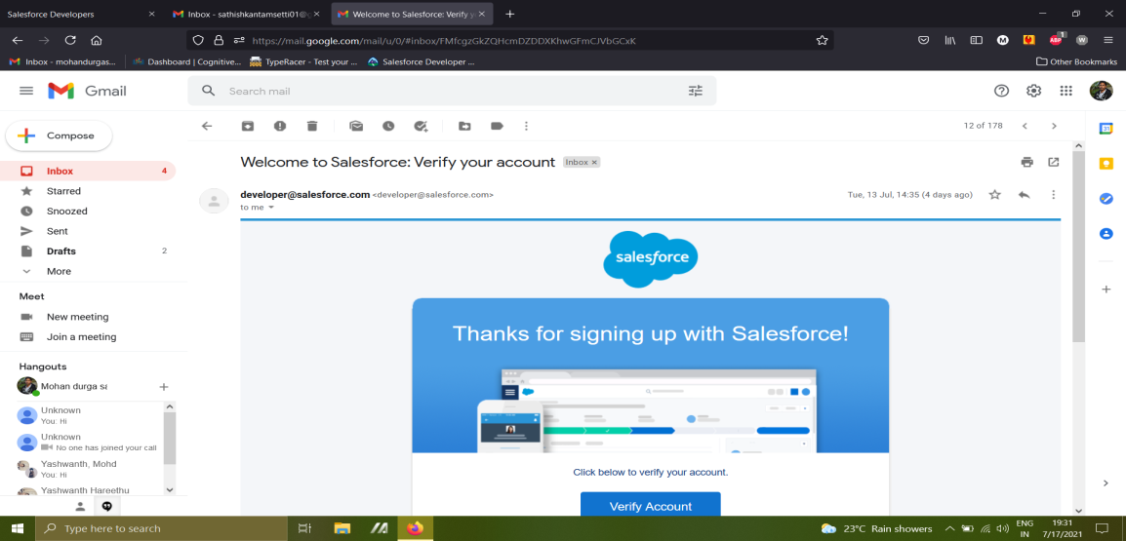
MILESTONE 1:
Go to developers salesforce.com/
Click on sign up
Enter the following details on the sign up fom
Click on sign up after filling this
Account Activation: (click on verify your aount)
Figure 1:-

Slide 5
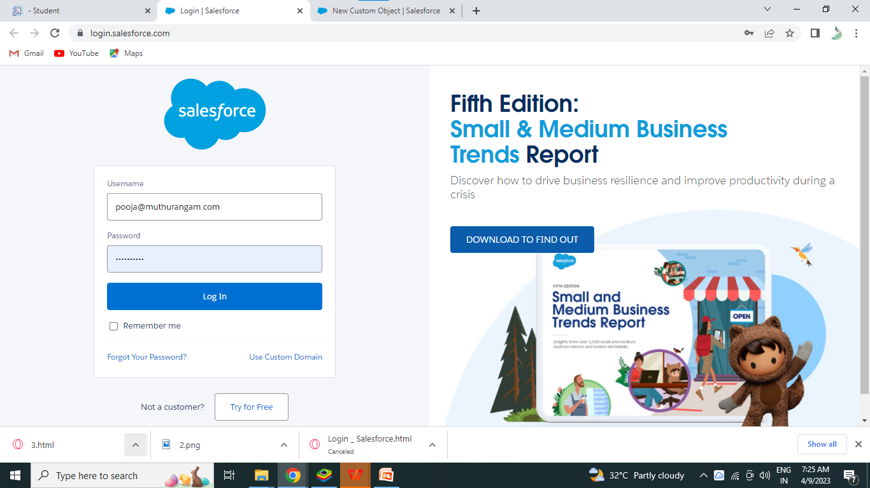
LOGIN TO SALESFORCE ACCOUNT
Go to salesforce.com and click on login
Enter the username password that you just created
After login this is the home page which you will see.
Figure 2:-

Slide 6
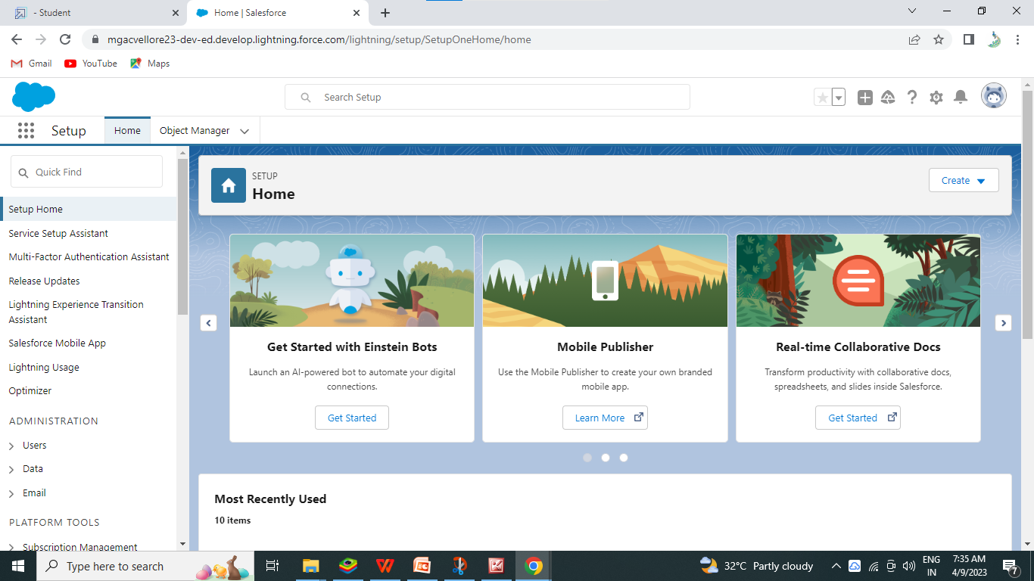
Figure 3:-

Slide 7
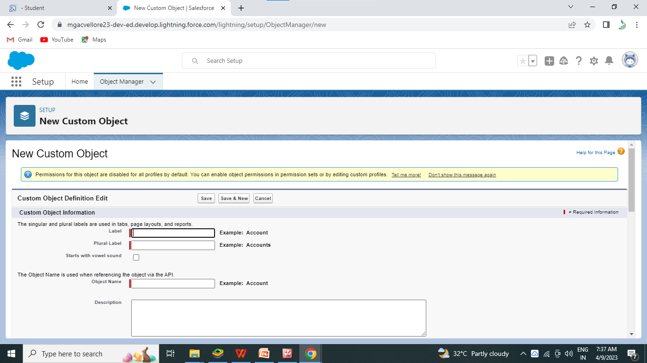
MILESONE 2:-
To Create an Object
(For this school management we need to create 3 objects: School,Parents and Students)
1)click on the gear icon and then selet setup
2)click on the object manager tab just beside the home tab
3)After the above steps, select custom objects page, ceate the object as follows
Figure 4:-

Slide 8
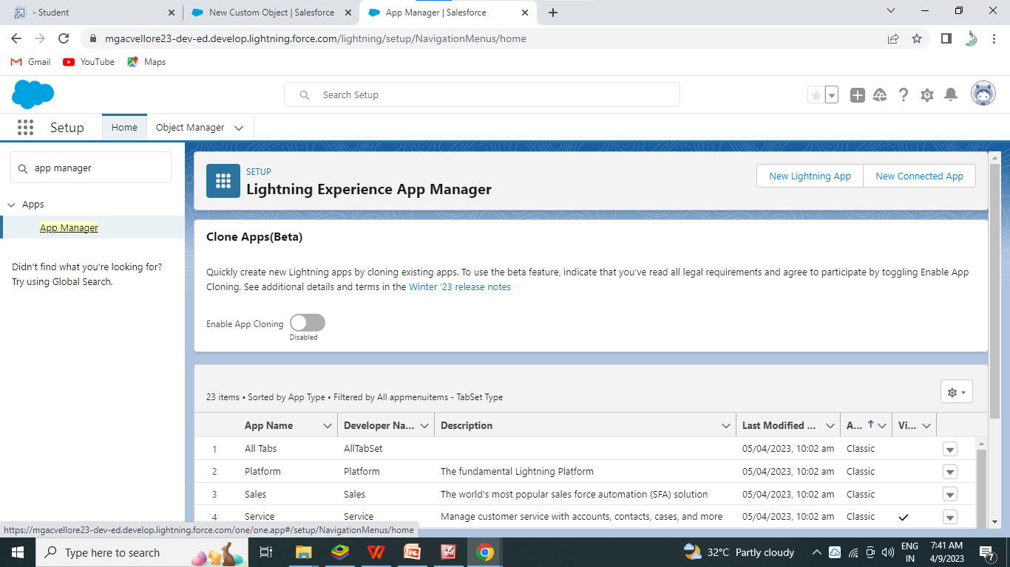
Milestone -3:
( Create the School Management app)
From Setup, enter App Manager in the Quick Find and Select App Manager
Figure 5:-
Click New Lightning App, Enter School Management as the App Name,then click Next

Slide 9
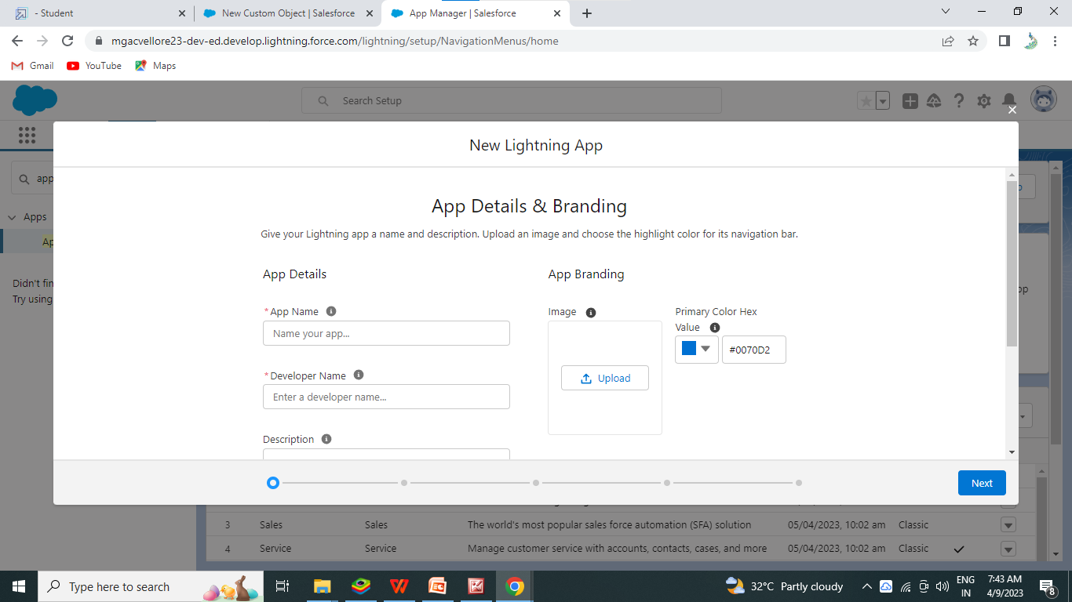
Figure 6:-
Under App Opions, leave the default selecions and click Next
Under Utiliy Items, leave as is and click Next
From Availble Items,select Schools,Students,Parents,Reports,and Dashboards and move them to Selected Items. Click Next.

Slide 10

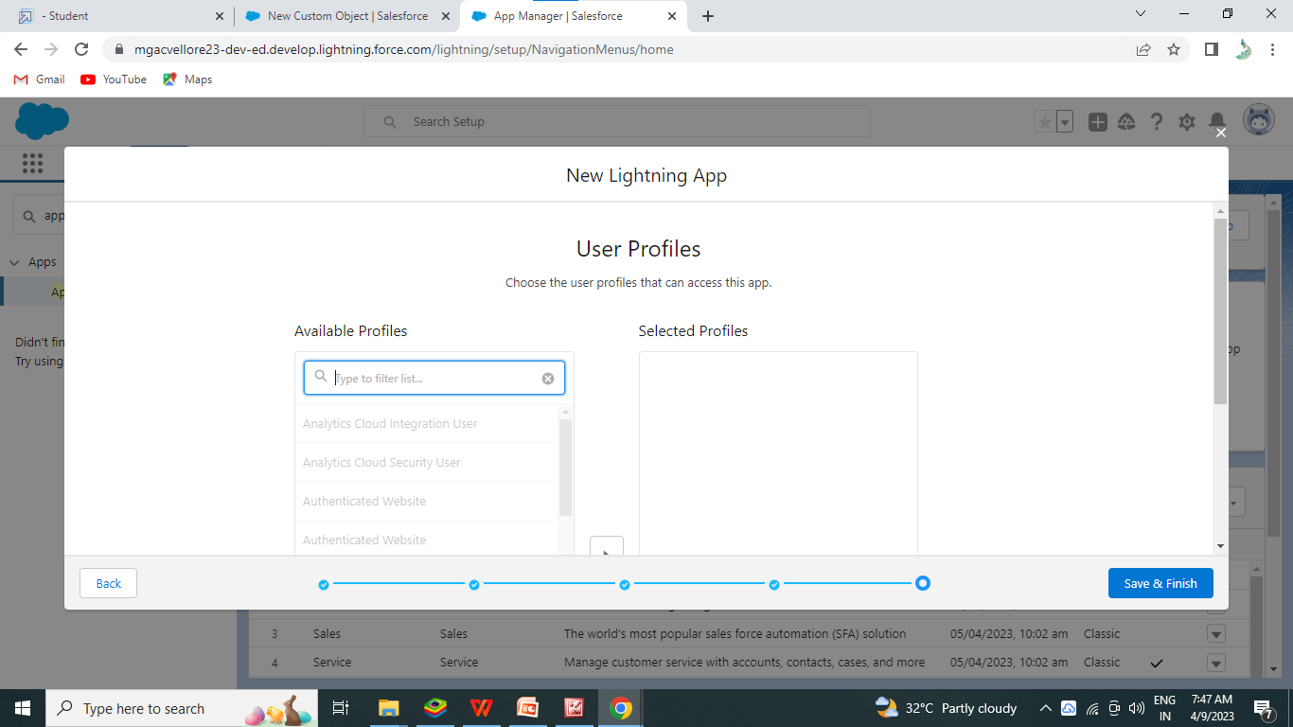
From Available Profiles ,select System Administrator and move it to Selected Profiles.
Click Save & Finish .
Figgure 7:-
To verify your changes,click the App Launcher,type Shool Management and select the School Management app.

Slide 11
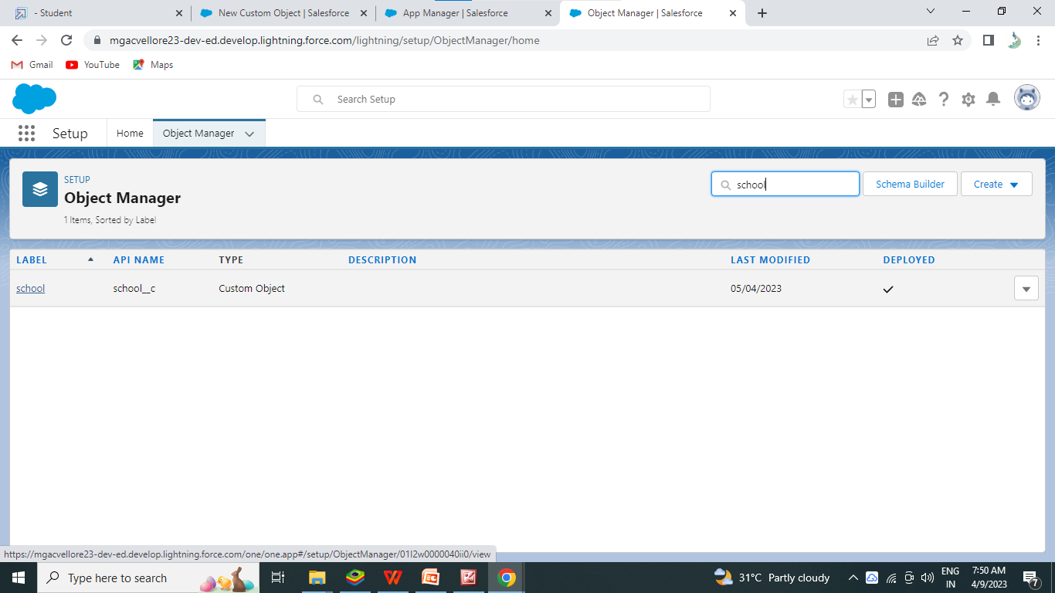
MILESTONE 4:-
Creation of fields for the School objects:
1)Click the gear icon and select Setup. This Launches Setup in a new tab.
2)Click the object Manager tab next to Home.
Figure 8:-
3) Select School.

Slide 12
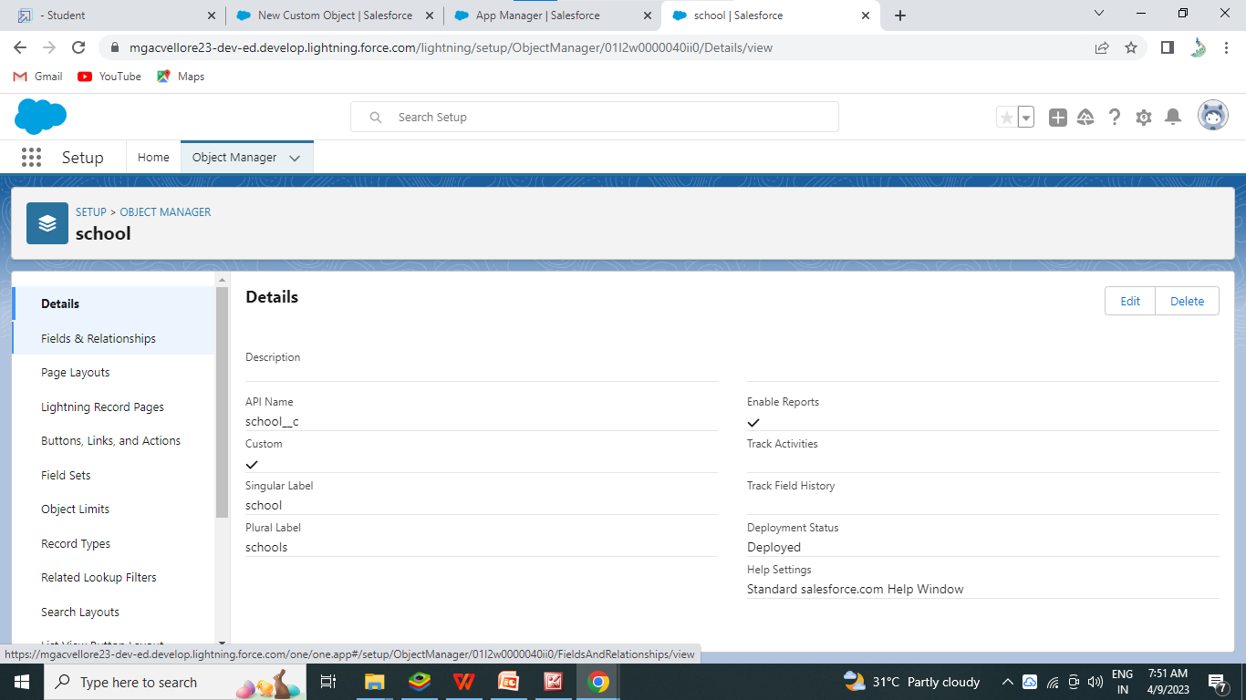
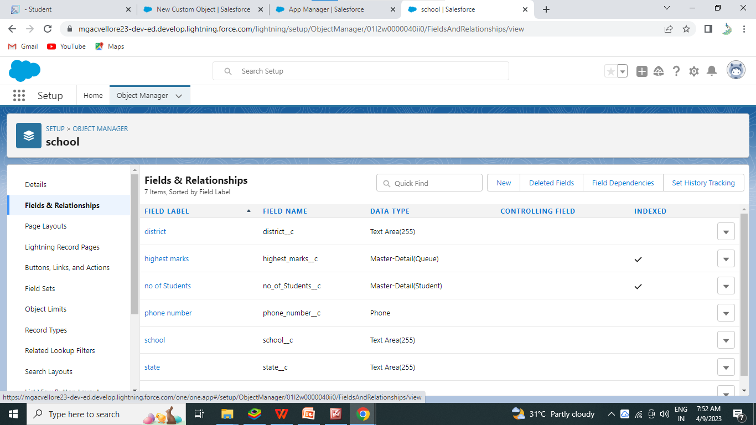
select Fields & Relationships from the left navigation , and click New.
Figure 9:-
Now we’re ready to make a custom field. Lets’s do this!
1)Select the text Area as the Data Type,then click Next.
2)For Field Label, enter Address.
3)Click Next, Next, then Save & New.
4)Follow steps 1 through 3 and create two more text areas with District,State and School websites as the field labels.
Now we're ready to make a custom field. Let's do this!
1. Select the Text Area as the Data Type, then click Next.
2. For Field Label, enter Address.
3. Click Next, Next, then Save & New.
4. Follow steps 1 through 3 and create two more text areas with District,State and School
websites as the field labels.

Slide 13
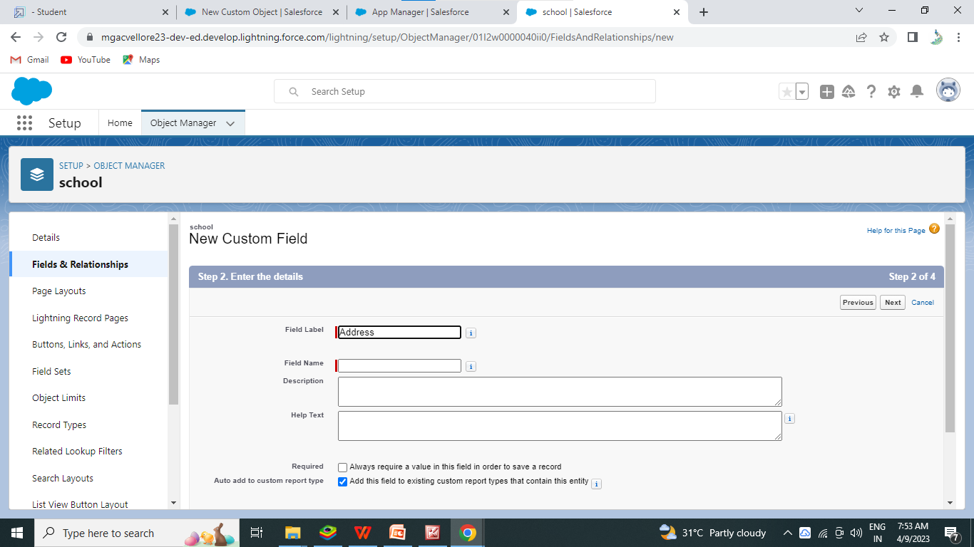
Now lets create the other fields and we must choose the data type carefully.
(select the data type as Phone, Roll- up summay ,master-detail Relationship, Pick-up List field, Number field, text area)
Create the fields for the student objects
Create the fields for the shool objects
Create the fields for the parent objecs
Figure 10:-

Slide 14
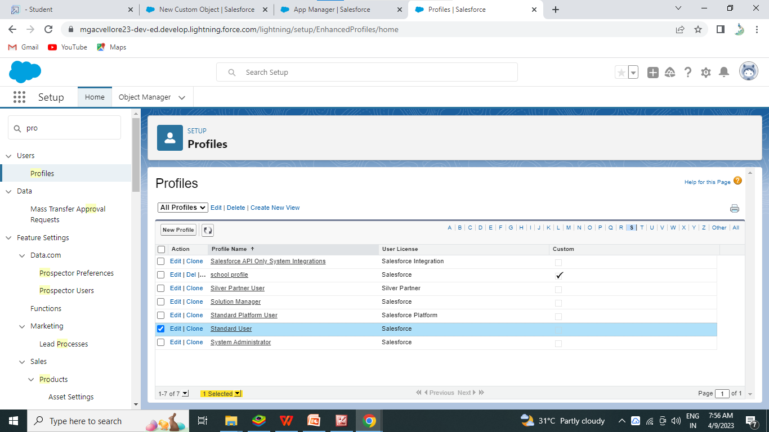
MIELSTONE -5:
(Creation on Pofile)
From Setup enter Profiles in the Quick Find box, and select Profiles.
1)From the list of profiles , find standard User.
2) Cick Clone.
Figure 11:-

Slide 15
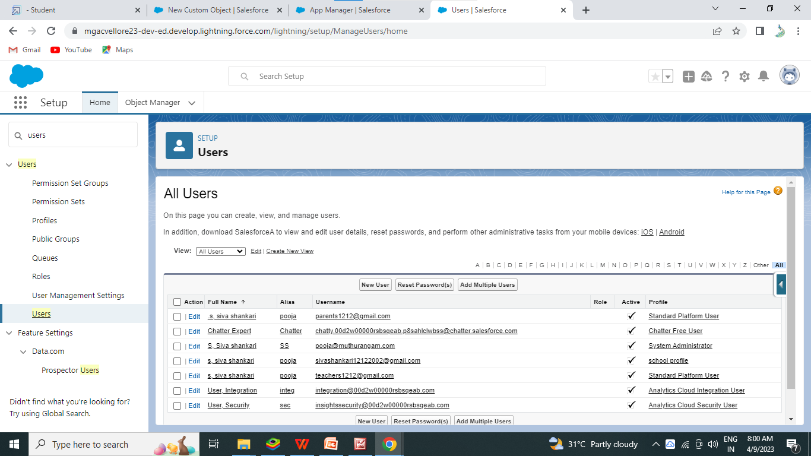
MILESTONE -6: Users
(Creating a Uses)
1)From setup, in the quick find box, enter users, and then select Users
2)Click New user
Figure 12:-
3)Enter the user’s name parents and (Your) email address and a unique username in the form of an emai address. By default, the username is the same as the email address.
4)Select a Use License As salesforce.
5)Select a pofile as a school profile.
6)Check Generate new password and notify te user immediately to have the user’s login name and a temporary password emailed o your email.

Slide 16
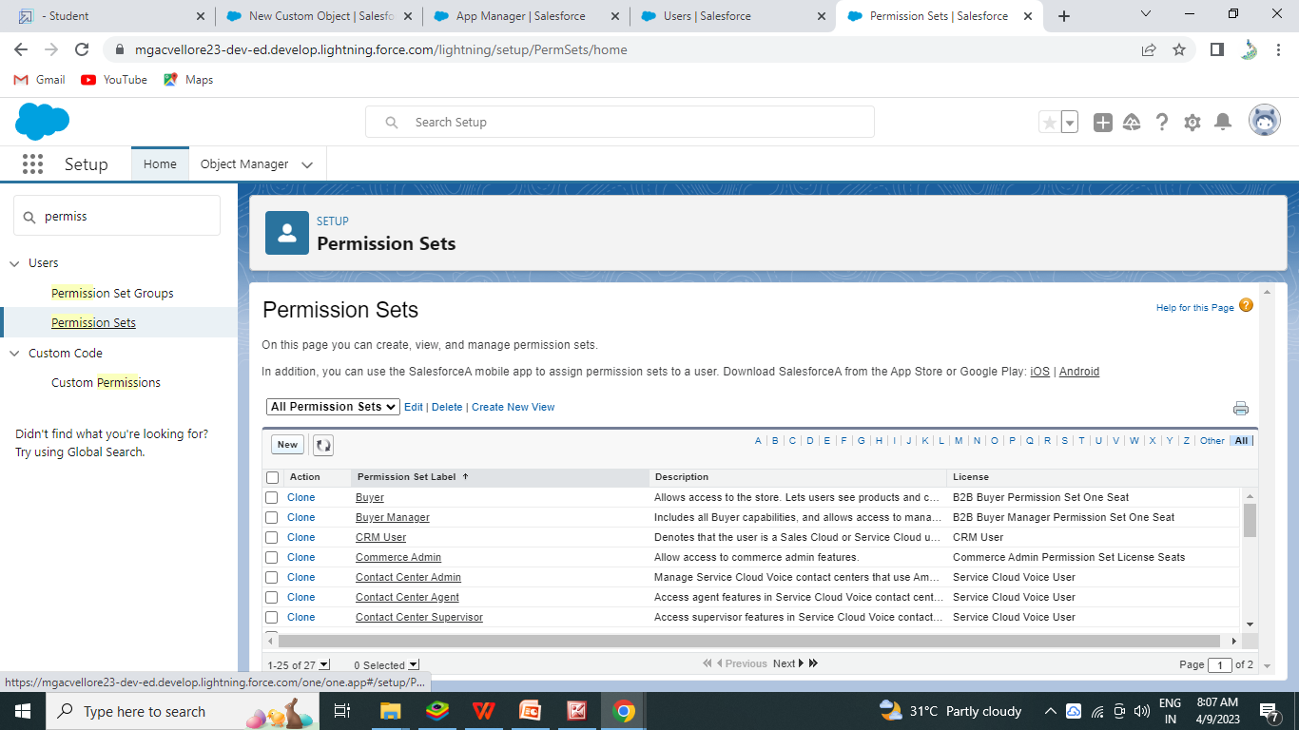
7) Similarly follow the above steps and create 3 users as Teachers and Prinipals.
MILESTONE -7:- Permission Sets
Permission Sets 1:
1)From Setup , enter Pemission Sets in the quick find box, then select Permission Sets.
2)Click New.
Figure 13:-

Slide 17
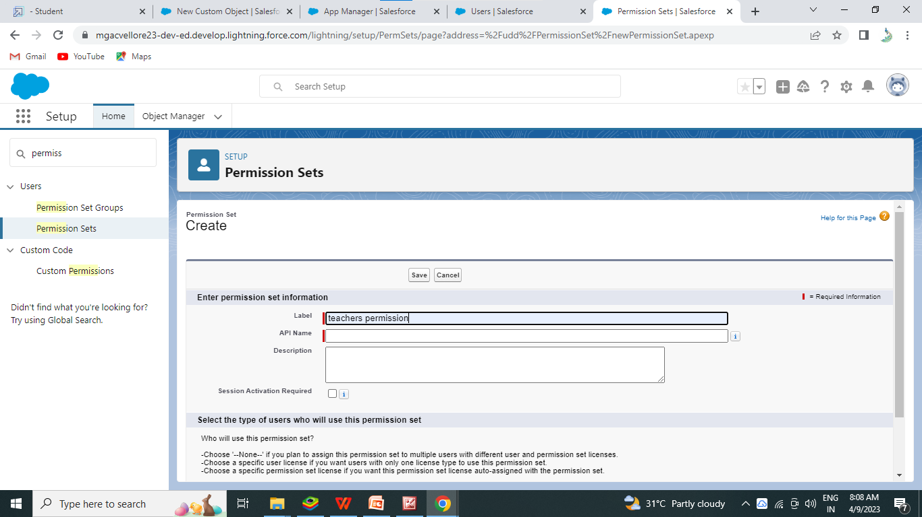
Figure 14:-
3) Give the name of the permission set name as teacher permission and then under the object settings give the view create and edit permission to all custom objects and assign to the teacher user.

Slide 18
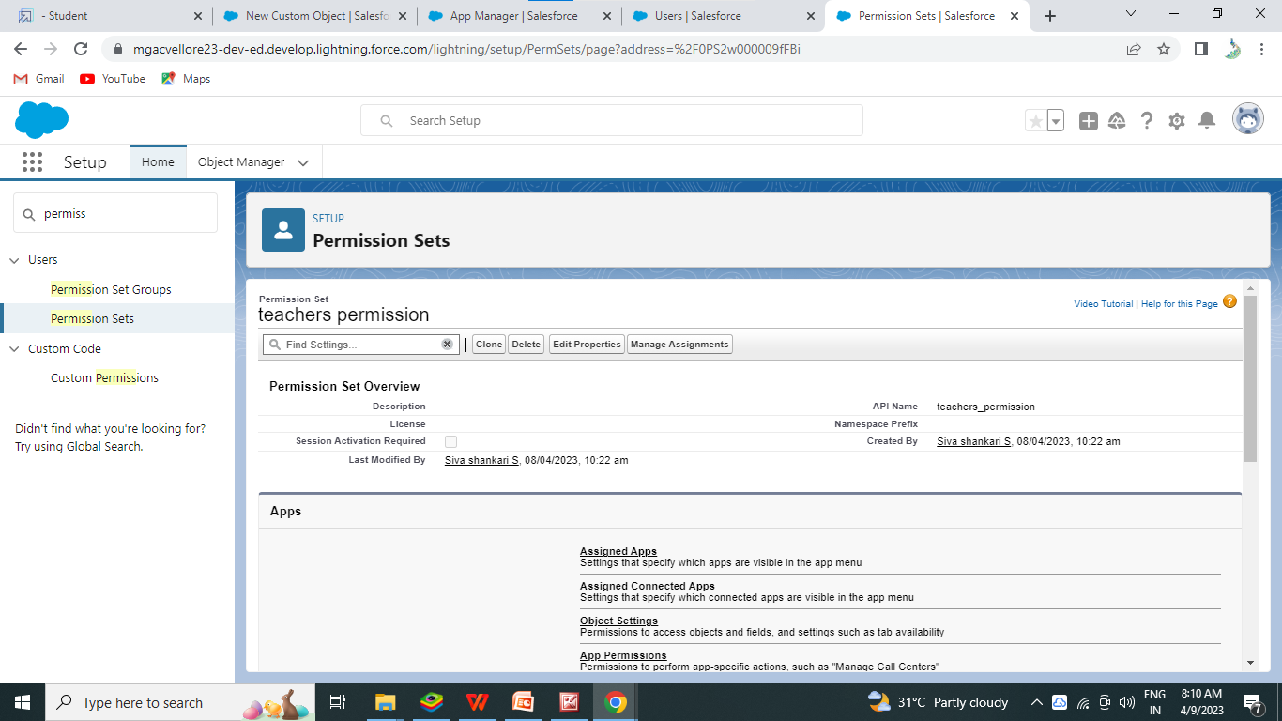
Figure 15:-

Slide 19
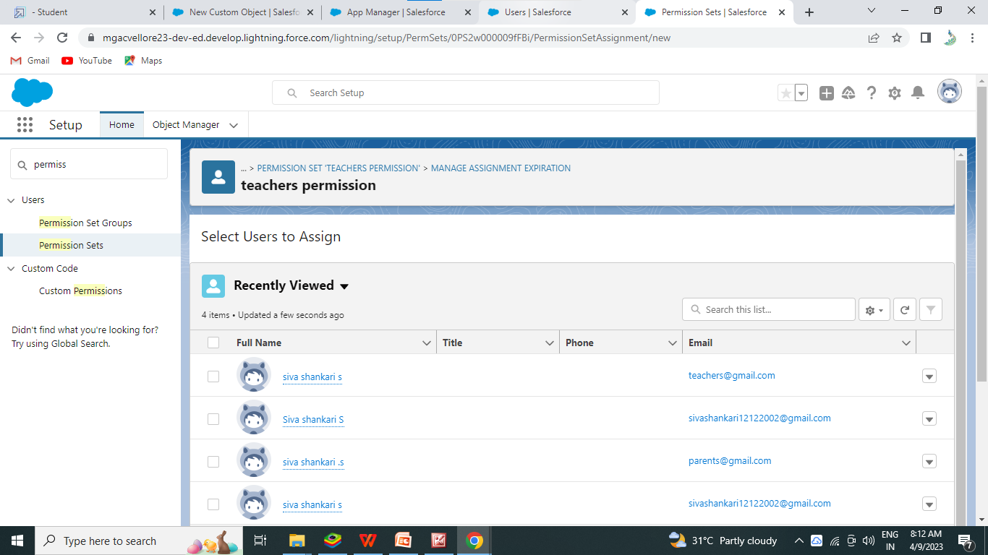
Figure 16:-
Similarly follow the above steps for the permission set 2
PERMISSION SETS 2:
1) Frrom setup, enter permission Sets in the Quick find box , then select permission sets
2)Click New
3)Give the name of the permission set name as Principal permission and then under the object settings give all permission for the objects and assign them to the Prinipal users.

Slide 20
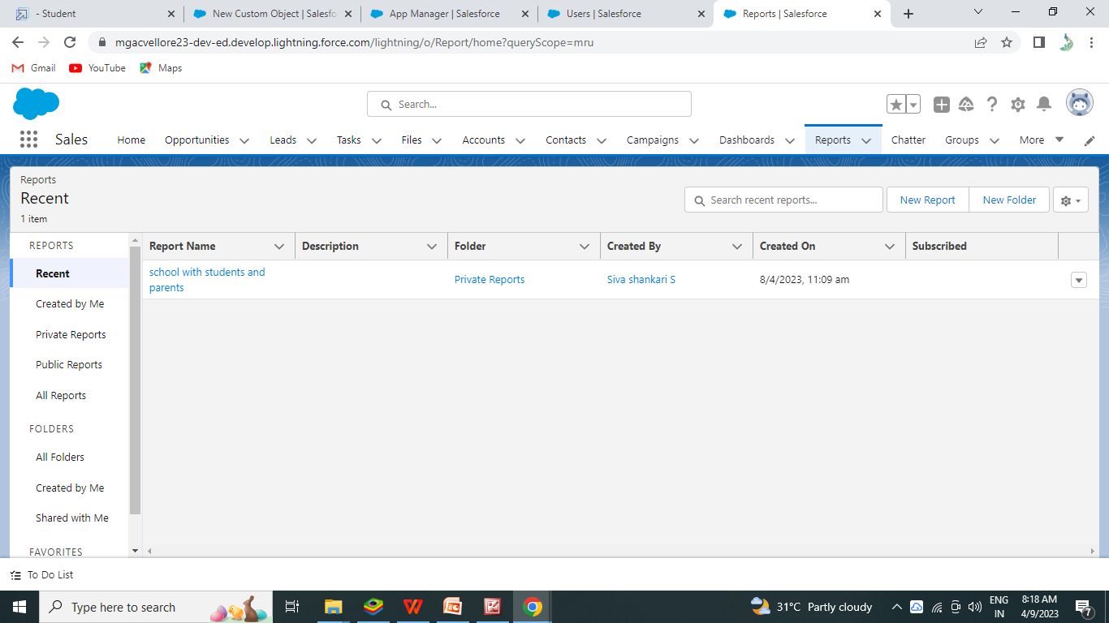
MILESTONE -8: REPORTS
1) From the Reports tab,click New Reports.
2) Select the report type as School with students and parents for the report,and click create.
Figure 17:-

Slide 21
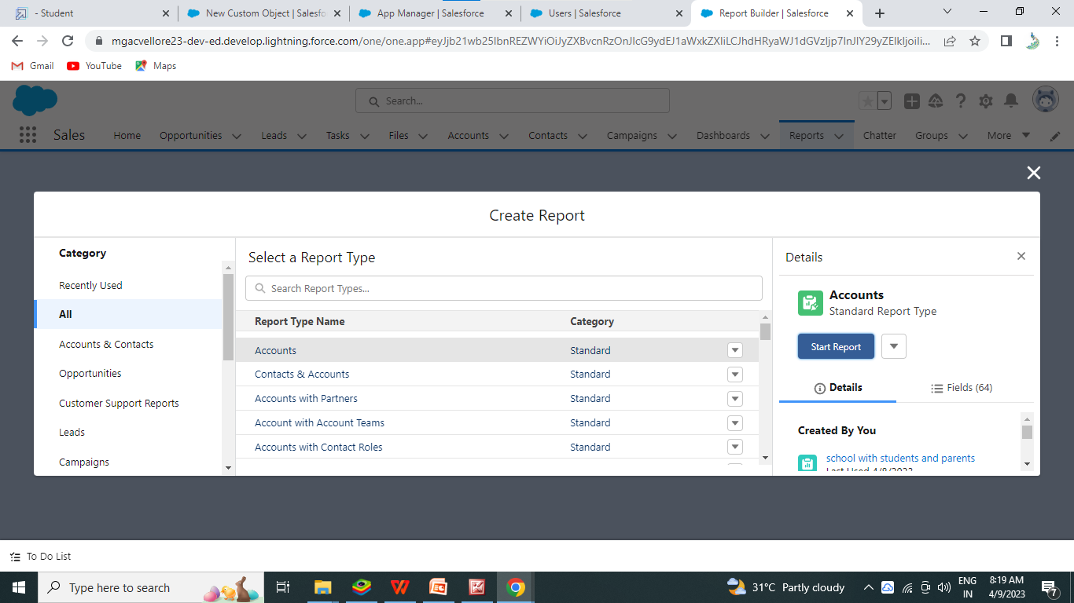
3) Customize your report, then save or run it.
Figure 18:-

Slide 22
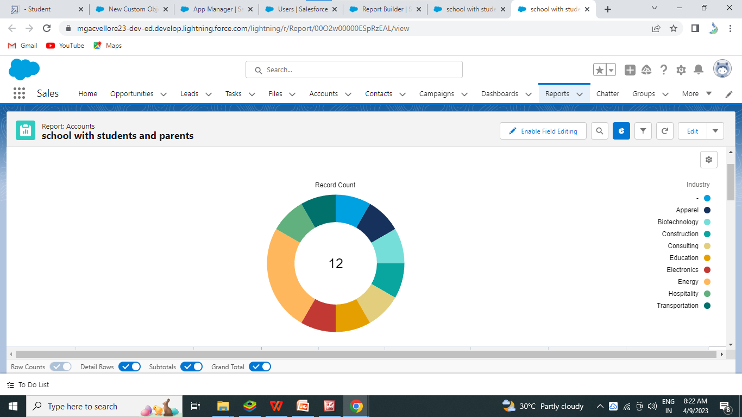
Figure 19:-

Slide 23
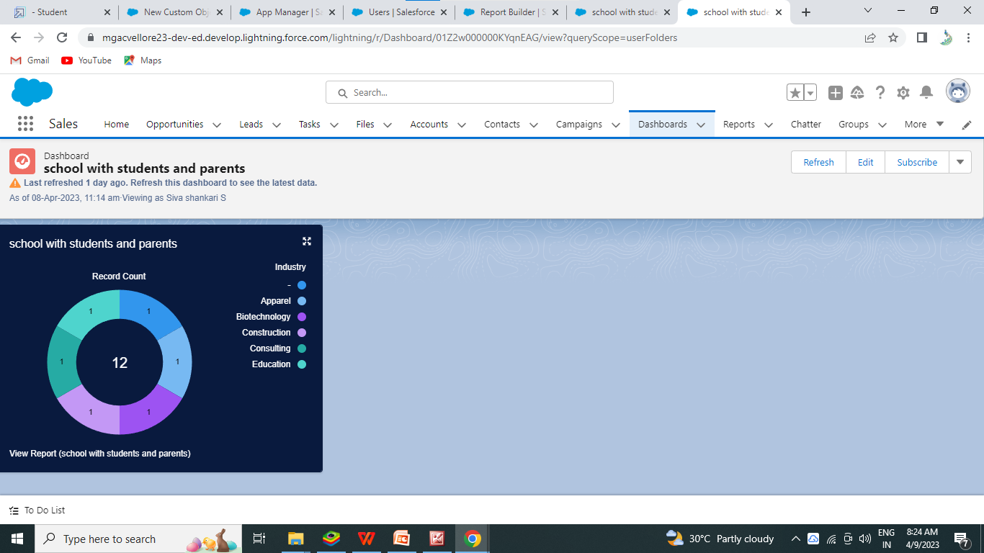
Creation of Dashboard
Ensure that value is record count and slicods by product name
Leave the deafault value
Click on add
And save the dashboad

Slide 24
END
Our Sincere Gratitude to:
SALESFORCE
SMART BRIDGE (Smart internz)

